Slide 1

CSC364-Software Engineering Week-2 Lecture-3 Semester-# Fall 2018
Prepared by:
M. Sajid Farooq

Slide 2
Instructor Contact Details
Name: M. Sajid Farooq
Course Instructor: CSC364- Software Engineering
Credit Hours: 3
Designation : Lecturer
Office Location: CS-Staff Room Cabin Sr#15
Email: msajidfarooq@lgu.edu.pk
Visiting Hours: Monday- Tuesday (1430-1600)
Lab Work: Video Tutorials & Supervision by Instr

Slide 3
Course Objectives
The main objective of this course is to provide a detailed view to Software Engineering and related topics.
The students will learn about the technical as well as the management side of Software Engineering.
They will acquire knowledge about fundamental principles of Software Engineering and also about practical approaches to securing Software Engineering.
Moreover, students should be able to work on UML and Software Engineering.

Slide 4
Software Engineering - A Layered Technology
Definition
Development
Support

Slide 5
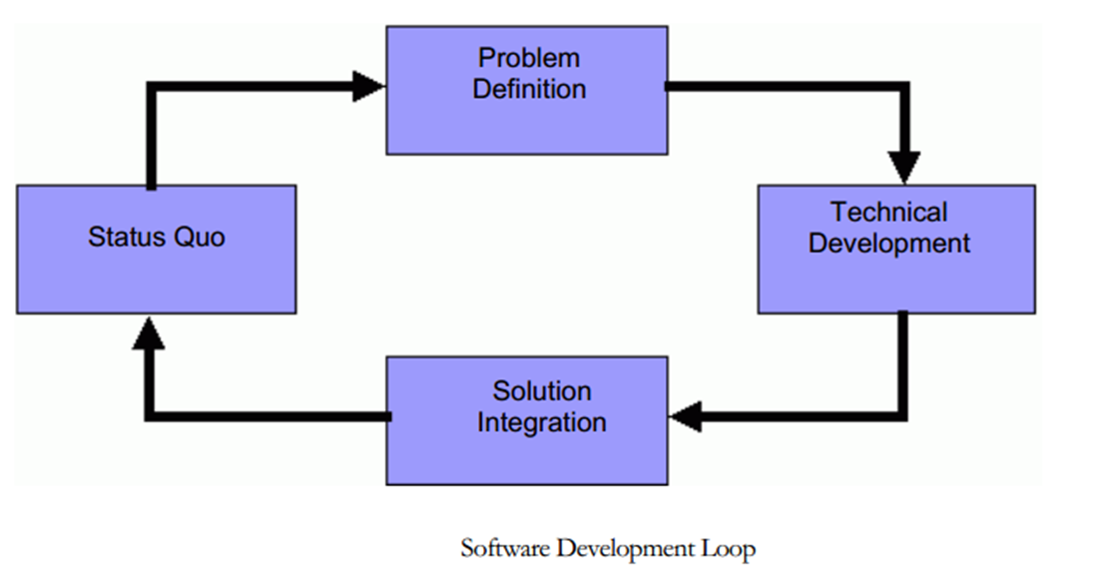
Software Development loop

Slide 6

Software process Maturity and CMM

Slide 7
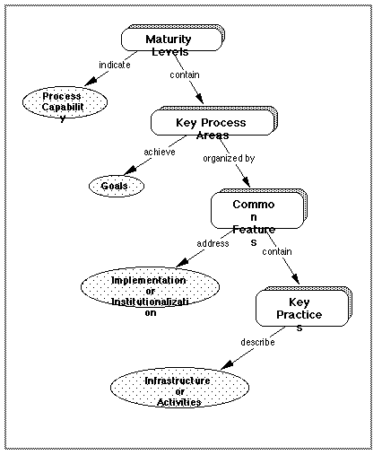
Structure of CMM

Slide 8
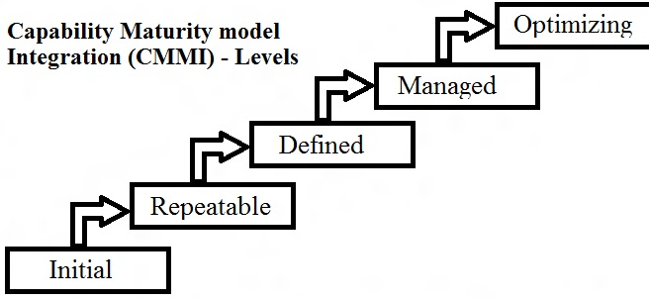
CMMI
“Software does not wear out!”

Slide 9
Level one-Initial
In level one, Organizations typically does not provide stable environment for developing and maintaining software.
In level one, normally Organizations lack sound management activities.
Software process continuously changed or modified
Schedules, budgets, functionality and project’s quality is not predictable

Slide 10
Level two-Repeatable
Basic project management processes are established.
We can predict and track cost, schedule, and functionality.
The necessary project discipline is in place to repeat earlier successes on projects with similar applications

Slide 11
Level Three-Defined
The software process for both management and engineering activities is documented, standardized, and integrated into an organizational software process.
All projects use a documented and approved version of the organization’s processes for developing and supporting software

Slide 12
Level Four-Managed
Detailed measures for software process and product quality are controlled. Both the software process and products are quantitatively understood and controlled using detailed measures

Slide 13
Level Five-Optimizing:
Continuous process improvement is enabled by qualitative feedback from the process and from testing innovative ideas and technologies

Slide 14
The End

Slide 15
Q & A

Slide 16
References
These lecture notes were taken from following source:

